Slide 1
Dept. of Land, Environment, Agriculture and Forestry
Seminar Announcement
Thematic area
Tuesday, 27th of February 2015
Title
Speaker:
Time 15:00-16:00
Place
Space for (eventual) picture
Space for other partners or research projects’ logos

Slide 2
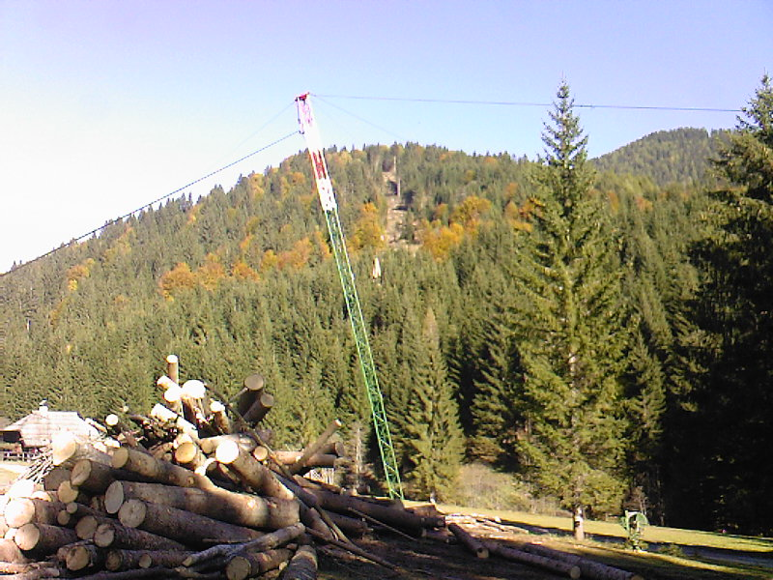
Dept. of Land, Environment, Agriculture and Forestry
Seminar Announcement
Forest Mechanization
Tuesday, 27th of February 2015
Innovation in forest logging activities: cable systems
Speaker: prof. Raffaele Cavalli
Time 15:00-16:00
Room 2, Stecca 1 Building – Agripolis, Legnaro
Space for other partners or research projects’ logos

